Slide 1
Slide Breakdowns
5 Minute Presentation Time
Title slide with all names, pictures and website/github urls (10 seconds)
Reminder of the project focus (20 seconds)
Daniel
Prioritized Sprint Goals (20 seconds)
Daniel
Major Sprint achievements/Feedback from Project Sponsor (20 seconds)
Colleen
Project Backlog and Sprint Backlog including cyber security related items and assessment (40 seconds)
Ryan
What was not completed / Lessons Learned (40 seconds)
Nick
Contribution by each team member (2 minutes)
Task breakdown (25 seconds each)
Short Video Demo (30 Seconds)
Sam
print 1 presentation content
◼ Title slide with all names, pictures and website/github urls
◼ Reminder of the project focus
◼ Prioritized Sprint Goals
◼ Major Sprint achievements/Feedback from Project Sponsor
◼ Project Backlog and Sprint Backlog including cyber security related items and assessment
◼ What was not completed (sprint 3 significant remaining work)/Lessons Learned
◼ AI tool(s) used and how they contributed to your productivity
◼ Contribution by each team member
◼ Live Demo of features (Sprint 1 may not have a real demo but a demonstration of what you have so far)
Sprint 1 Submission Checklist
The following documents should be POSTED on the Project website and submitted via Blackboard:
Project planning document for sprint
Project backlog snapshot
Sprint backlog
Sprint presentation
Scrums documented in discussion group
All source code changes committed to Github
Students will present using submitted slides downloaded from blackboard
◼ 5 minutes
◼ Everyone should talk and present their contributions
Presentation criteria:
Each rubric is broken into 3 parts. The first is the content. The content of Sprint 1 presentation is listed above. The second part focuses on slides and considers graphics, mechanics and organization. The third part is specific to each person and considers presentation skills (elocution, etc) and knowledge. The knowledge part doesn’t always come into play because we don’t have time to ask each person a question. However, sometimes it is clear that a student does not know what is going on with the project
Notes:
Ryan

Slide 2
Driveability Website
Samuel Wisnoff, Colleen Grimshaw,
Nicholas Yeager, Ryan Douglas,
Daniel Szurek

Slide 3
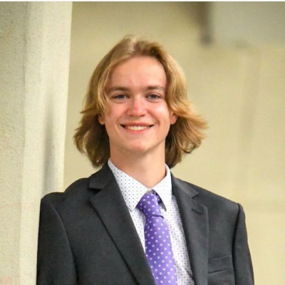
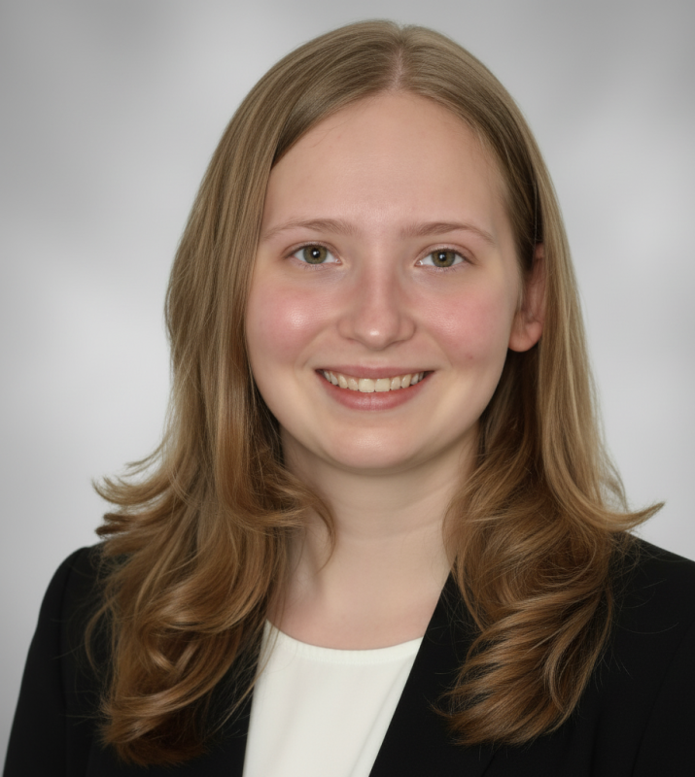
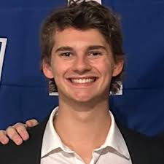
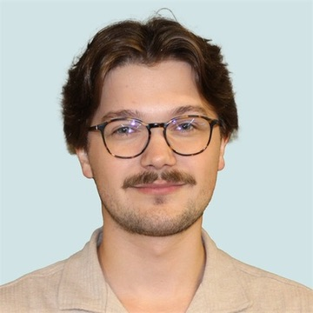
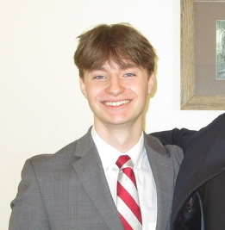
Nicholas Yeager
Colleen Grimshaw
Samuel Wisnoff
Daniel Szurek
Ryan Douglas
Website URL: https://driveabilitycapstone.netlify.app/
Notes:
The project Github requires an NDA to access

Slide 4
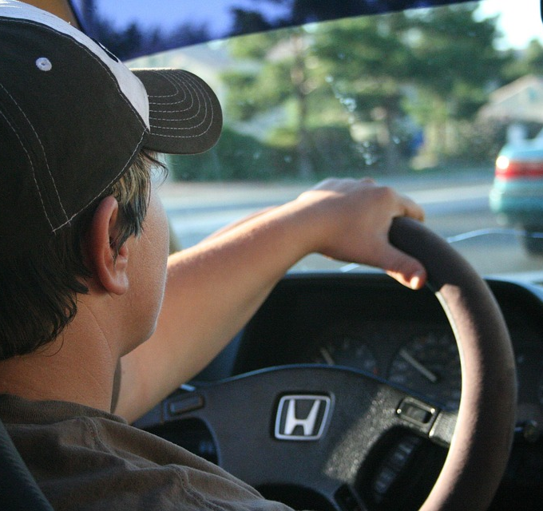
Project Focus
Develop a website that acts as a forum and guide for impaired individuals looking for a comprehensive resource on driving with physical impairments.
Notes:
Daniel

Slide 5
Sprint 1 Goals
Frontend User Profile Finalization
Developing User-facing settings pages
Reviewer Application
Frontend Admin Dashboard
Creating reviewer approval UI
Review management UI
User management
Backend Logic
User management
User vs. Reviewer vs. Admin logic
Profile creation logic
Backend -> Frontend connection API
Notes:
Daniel

Slide 6
Sprint Achievements and Sponsor Feedback
Achievements
Sponsor Feedback
Created frontend functionality for admin management capabilities
Can approve user accounts
Improved frontend functionality for user profile
Add and edit personal information
On pace based on pre-determined Sponsor Sprint 1 expectations
Decided to add a resources section
Pull articles from approved sources
Need way for promotion of users to admin
Future focus on Security
Remove bad actors
Notes:
Colleen
"For our achievements we: created frontend functionality for admin, primarily the ability to approve users, improved functionality for users: adding personal info such as height weight, and impairments"
"As for Sponsor feedback, they want to add a resources section, want a way to promote users to admin, and want to add security protocols"

Slide 7
Project Backlog
55 Total Remaining Tasks
Due to the additional scope of the resources page, our remaining tasks have a heavy emphasis on Frontend I features.
Notes:
Ryan

Slide 8
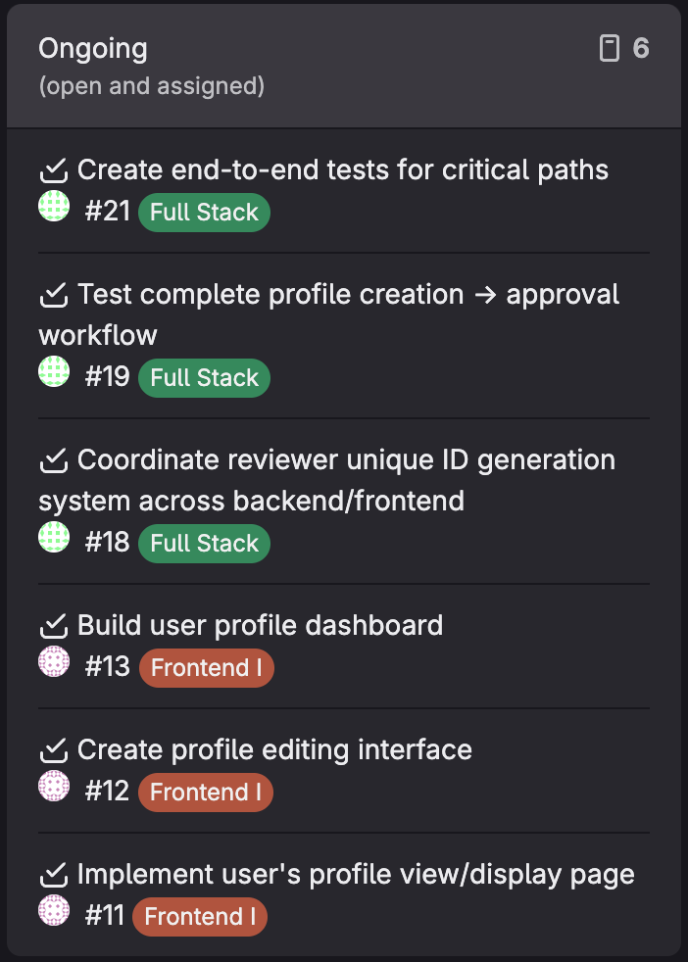
Sprint Backlog
Tasks have shifted in scope over the course of the sprint to align with stakeholder priorities
Thus, 6 out of 25 Sprint 1Tasks have been shifted to Sprint 2

Slide 9
Cybersecurity Considerations
Biggest Hazards
Current Protections
Next Steps
Input Sanitization
Cross Site Scripting
CSRF
Token Based Attacks
JSON Web Tokens to authorize users
All API calls pass through middleware to authorize the users
Rate Limiting on Requests
Cleaning raw text inputs
Stronger HTTP Header Protections

Slide 10
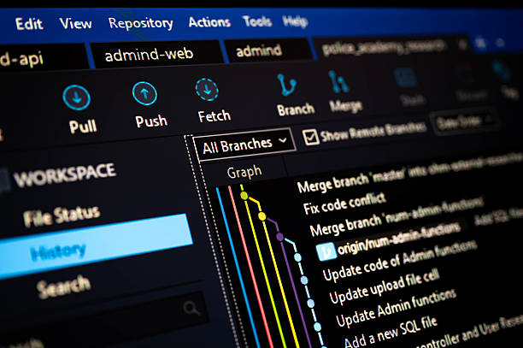
Lessons Learned
General flow of SWE teamwork
Gained an understanding of preexisting codebase
Properly understanding task intensity/time requirements
Notes:
Nick

Slide 11
Task Breakdown

Slide 12
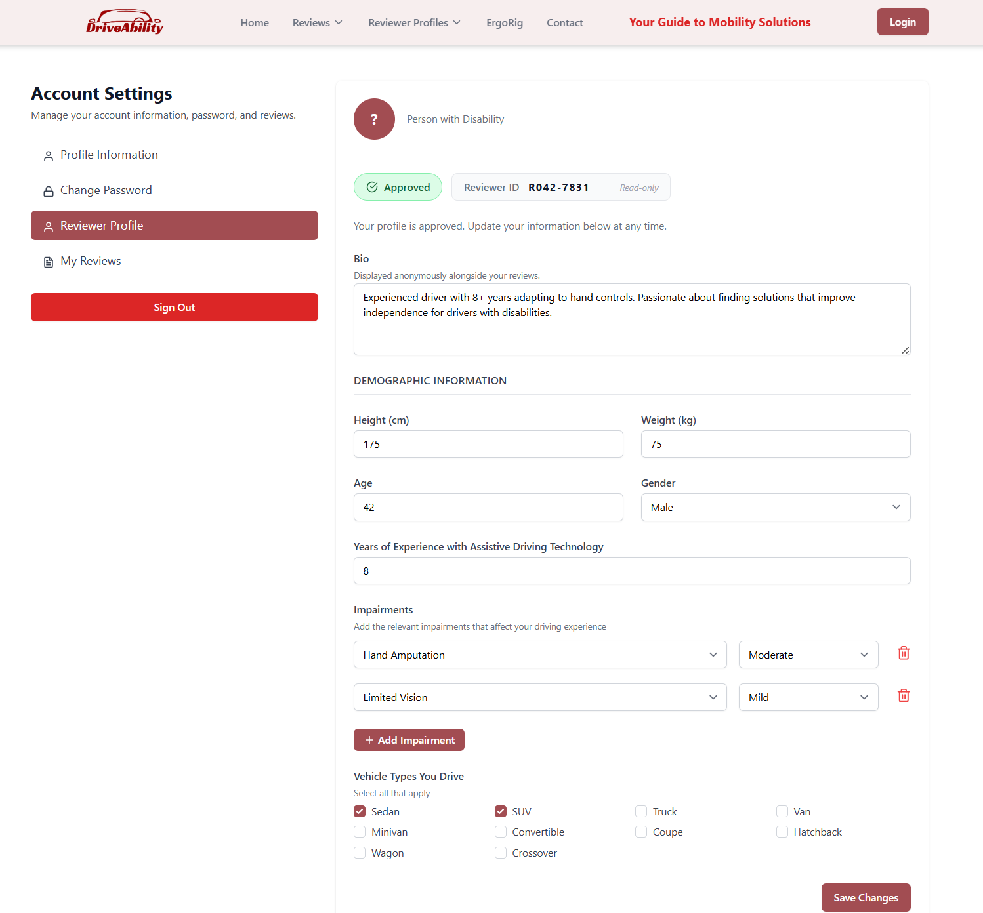
Frontend I: User Oriented
Tasks:
Set up the profile creation form for users
Improve user's profile dashboard
Improve user ability to edit profile information
Allow users to view other profiles
Notes:
Colleen

Slide 13
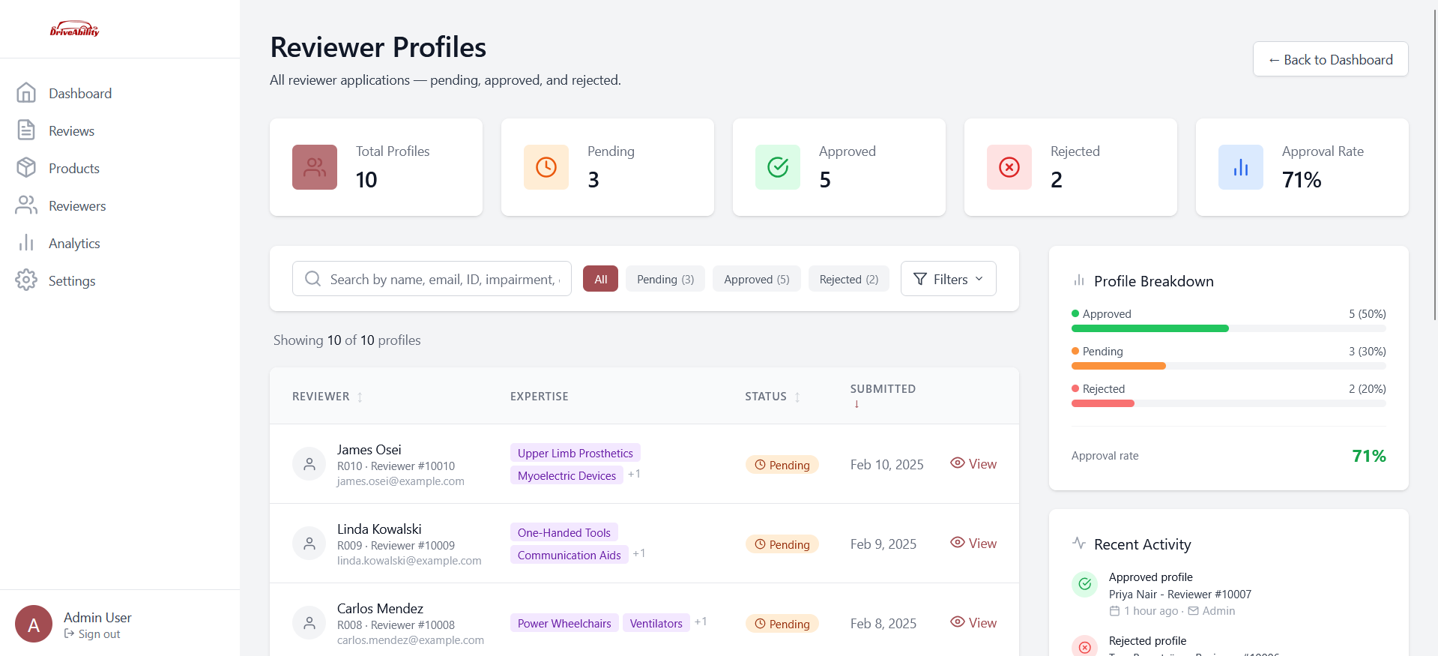
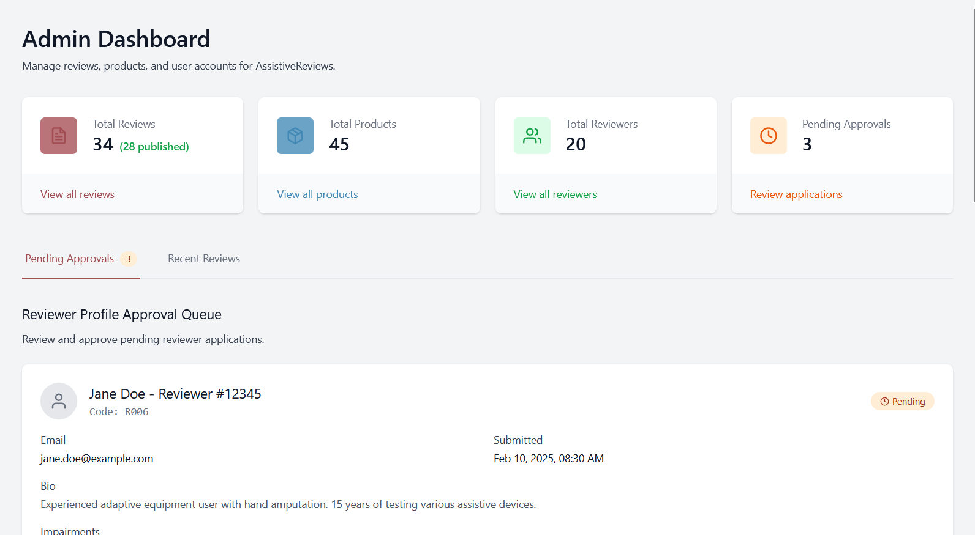
Frontend II: Admin Oriented
Tasks:
Build Admin statistics display
Create admin profile management views
Implement profile approval/rejection interface
Build admin dashboard for profile approval queue
Analytics and application review routing functionality

Slide 14
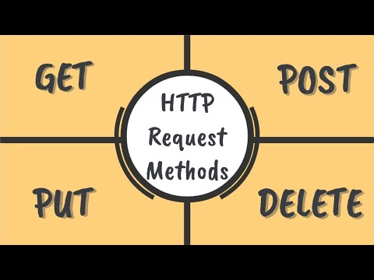
Backend I: Client Side
Tasks:
Each new user profile has a unique code generated
Fetch user's profile information using unique code
Maintains anonymity except for admins
Users able to edit profile information
Explicitly states which demographic info can be changed
User data updated in MongoDB
Notes:
Sam

Slide 15
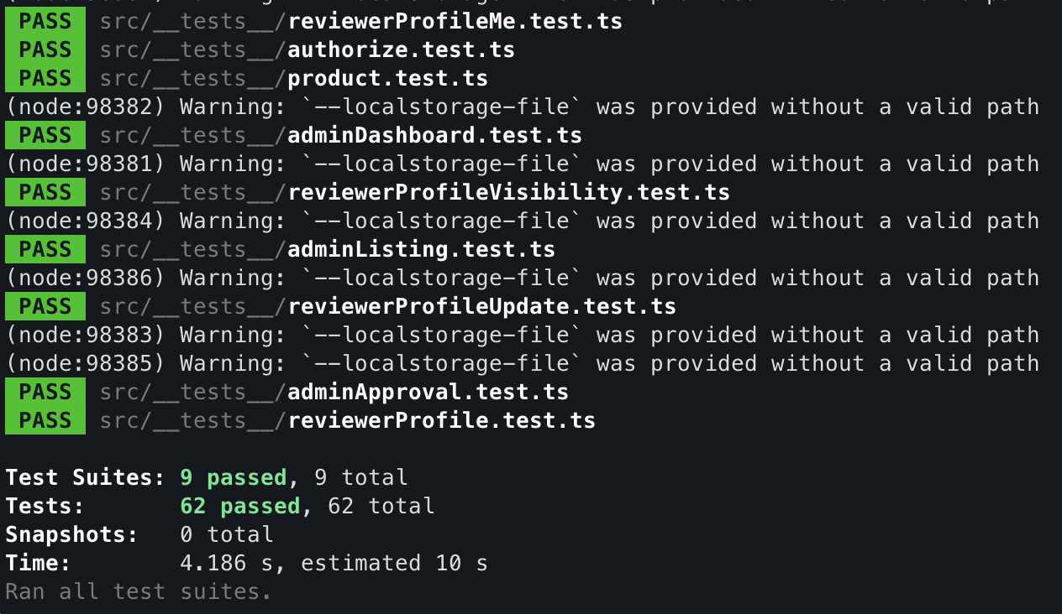
Backend II: Admin Oriented
Tasks:
Implement Profile Status Management Logic
Implement Authorize Middleware Function
Create Admin Dashboard Data Queries
Build admin profile review/listing endpoints
Implement Admin Approval/Rejection Endpoints
Implement Testing Framework

Slide 16

Full Stack
The full stack role focused on bridging the gap between the frontend and backend developers.
This included:
Coordinating user ID generation and usage
Creating and managing the API workflow
Managing merge requests
Merging developer branches into a master branch

Slide 17
Demo
Notes:
Sam
Explanation of what is currently implemented. Does not have to be a full blown demo.

